Slide 1

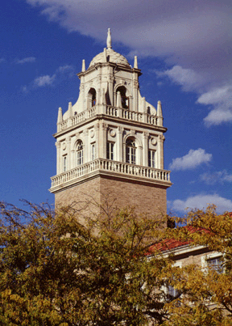
HealthTvizer: Exploring Health Awareness in Twitter Data through Coordinated Multiple Views
Presenter
Dr. Tommy Dang
Assistant Professor, Texas Tech University
PhD Students
Ngan Nguyen
Vung Pham

Slide 2
Outline
Introduction
Background and related work
Visualization architecture
Use cases
Future work

Slide 3
Project Overview
Analyzing public user posts and shared information on social media can assist us in measuring various population characteristics, patterns, movements, as well as the public health conditions.
In this paper, we present a social media analytics tool, called HealthTvizer, for exploring health awareness using Twitter data through interactive and interconnected multiple views.
We demonstrate HealthTvizer on more than 130k disease-related tweets (extracted from over 57 million tweets) in January 2017.

Slide 4
Project Overview
When dealing with public health information, domain experts concern on the following issues:
Q1: What public health information can be learned from Twitter?
Q2: Are there any geographical areas where people are prone to specific diseases?
Q3: Is there any relation of diseases with exercise or general daily behavior which we can infer from tweets?
Q4: Which diseases are more discussed in social media and if there is a gap with respect to an actual scenario?

Slide 5
Project Overview
We adopt three step metaphor for information visualization: overview first, zoom and filter, and then details-on-demand
T1: Provide a summary view of popular diseases and keywords over time.
T2: Details on demand
T3: Data filtering
T4: Order terms in the streamgraphs as well as the word clouds
T5: Our HealthTvizer represents the relationships among the hot keywords and diseases in a force directed layout.

Slide 6
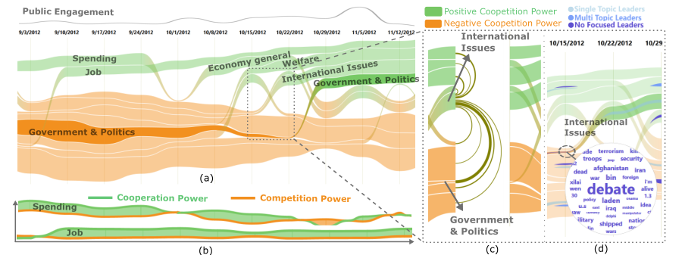
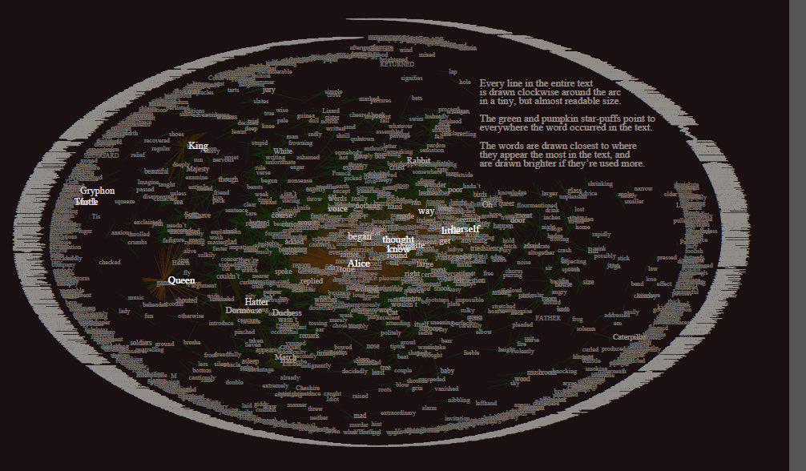
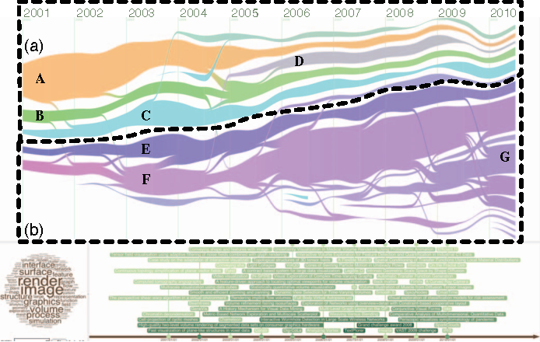
Related work
EvoRiver separate the negative and positive threads
Text visualization
+ focus on topic evolution
- not their correlations
TextFlow
TextArc

Slide 7
Processing Twitter data
We collect tweets geolocated in the US from Jan 6 to Jan 31, 2017, which includes 57,934,000 tweets.
We query Datasift’s streaming API to collect tweets that also have meta-information including geographical coordinates...
Tweets filtering: We are interested in the disease-related tweets. According to Healthcare Hashtag Project, there are 21 main disease categories such as Cancer, Psych
Each category contains a list of keywords which can be referred to the disease. By filtering this set of keywords, we are able to get each disease’s tweets.
The total number of disease-related tweets is 12,6915, accountingfor 0.22% of the total number of tweets from Jan 6 to Jan 31,2017

Slide 8
Visual components

Slide 9
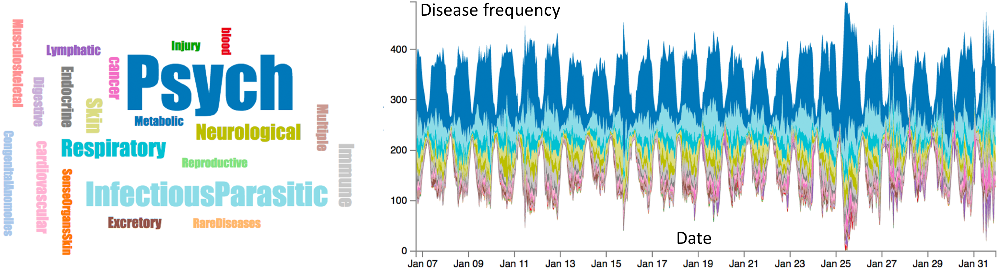
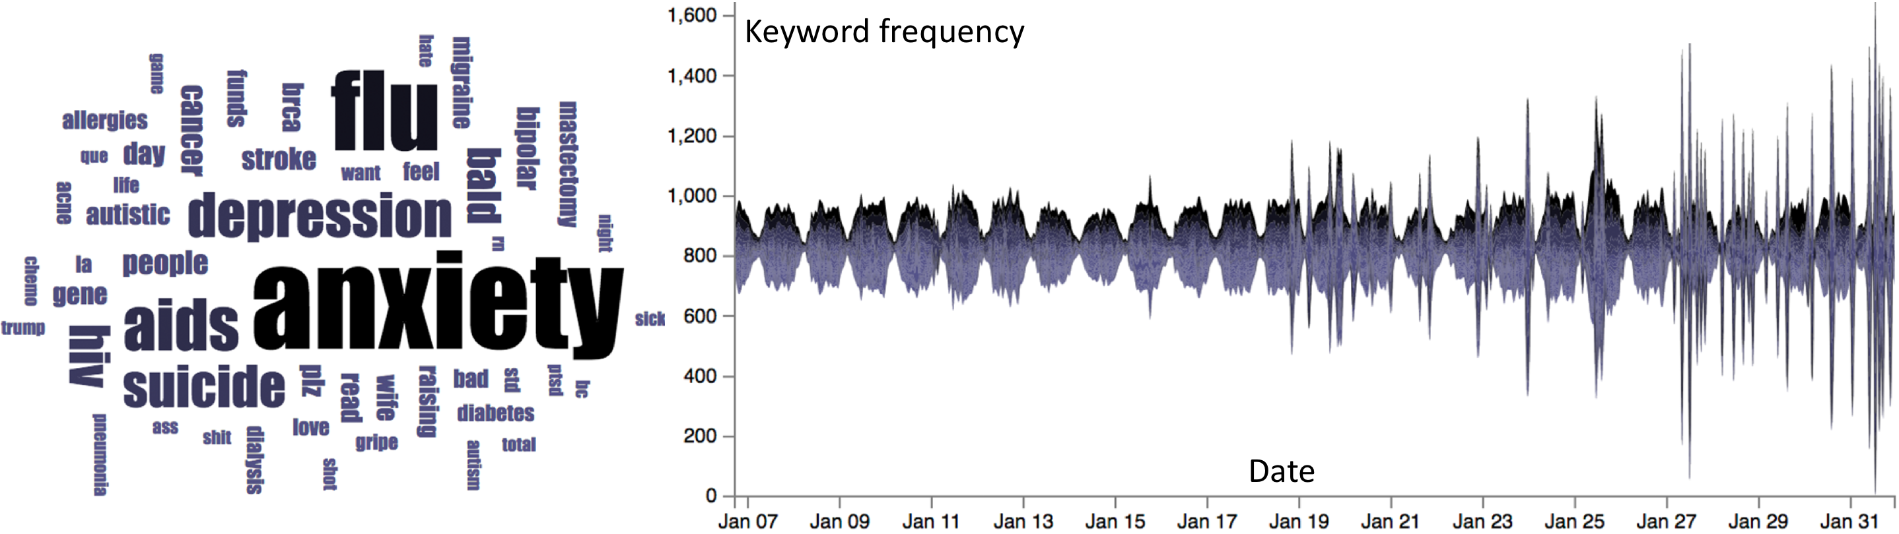
Visual components

Slide 10
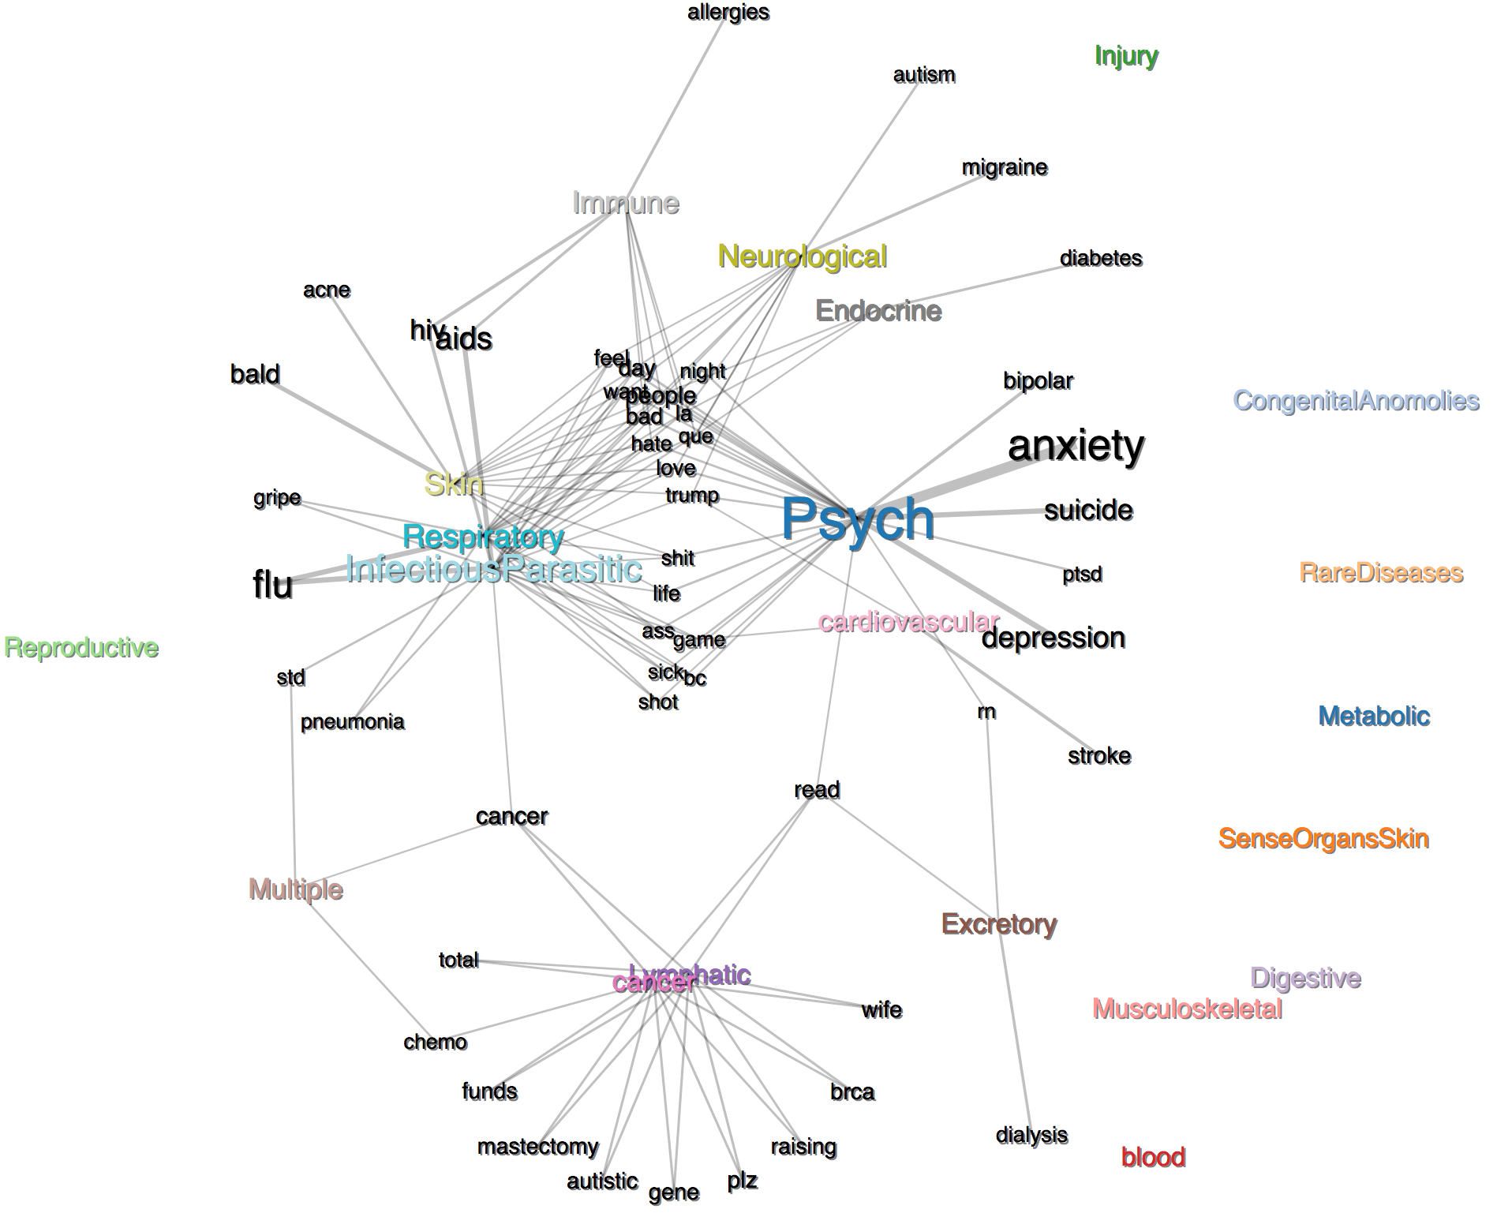
Visual components

Slide 11
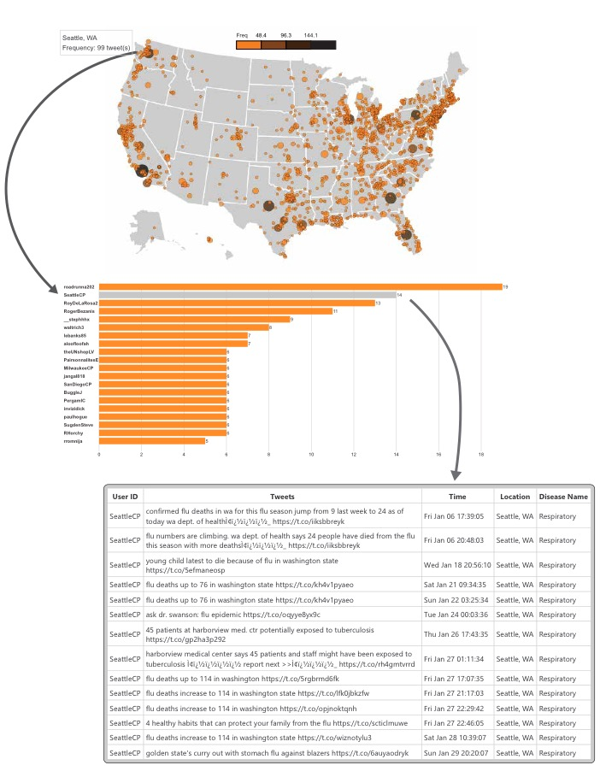
Visual components

Slide 12
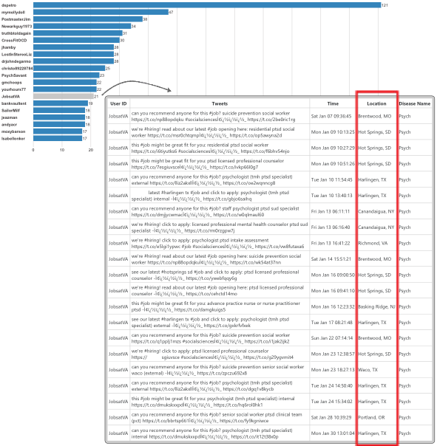
Visual components

Slide 13
Use case 1: Cancer
During January of 2017 the user ID: DwightJasonBain started a fundraising organization for his wife (who is suffering from breast cancer)
As this person lives in Running Springs, CA and people in that area retweets the appeal for raising fund, the tweets became spread out, causing a huge number of tweets in that area.

Slide 14
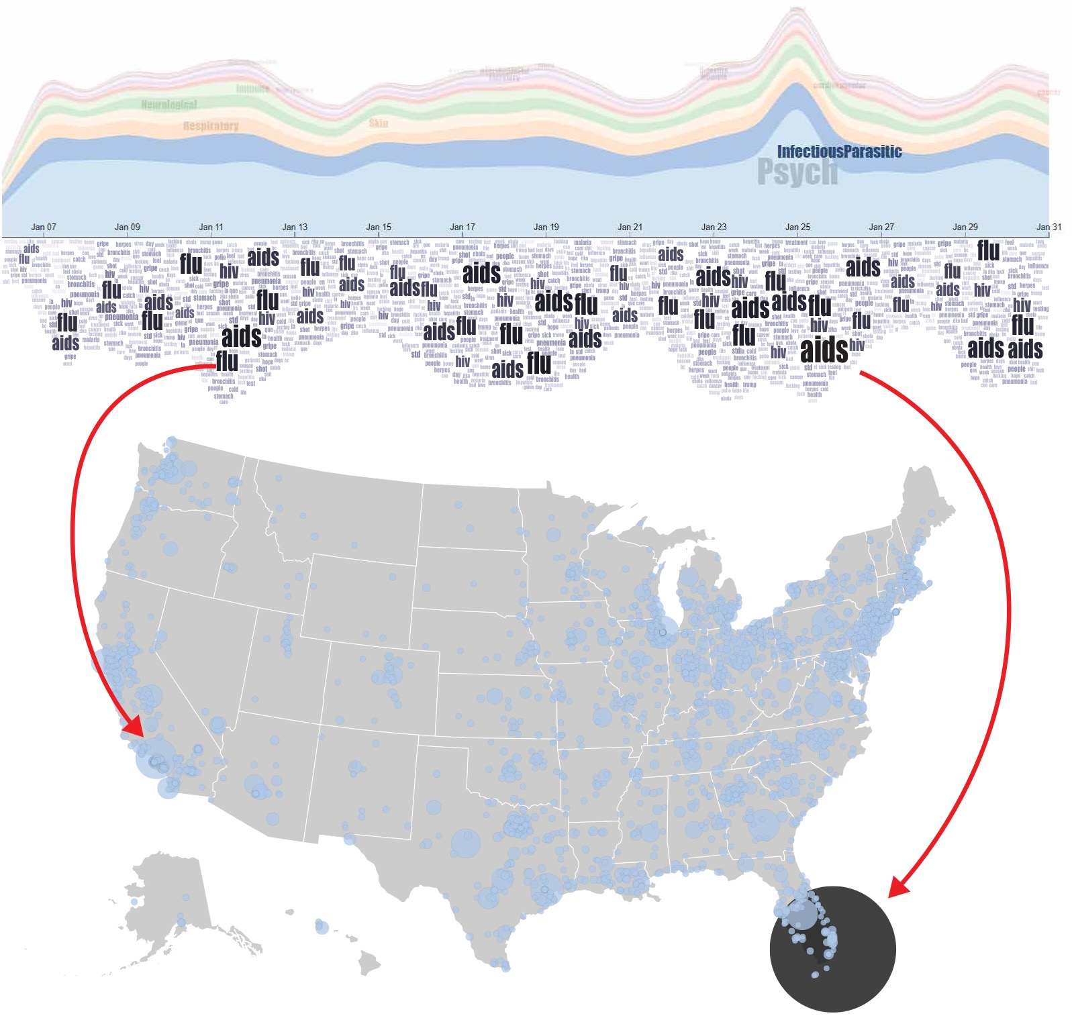
Use case 2: InfectiousParasitic
Stigmabase works on the awareness ofvarious diseases, especially on AIDS. They shared the tweets about the work of Merck
On January 27th in Seattle, WA, a news published on several websites (e.g. Washington Times) stating that the number of death because of Flu increases to 114 in Washington state. There was plenty of tweets related to this issue => these types of reports create awareness and fear among the people

Slide 15
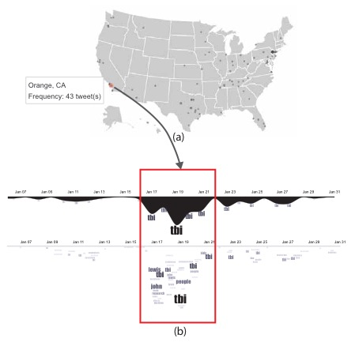
Use case 3: Injury
Our exploring shows us that on January 17th the Fox News Insider published a news related to the
list of Democrat who won’t attend Trumps Inauguration. One the Twitter user with the ID
LyndaRe06304657 started to tweet about the reason. The user referred that John Lewis, the
Democrat congressman, had a brain injury, so those Democrats need to take care of it

Slide 16
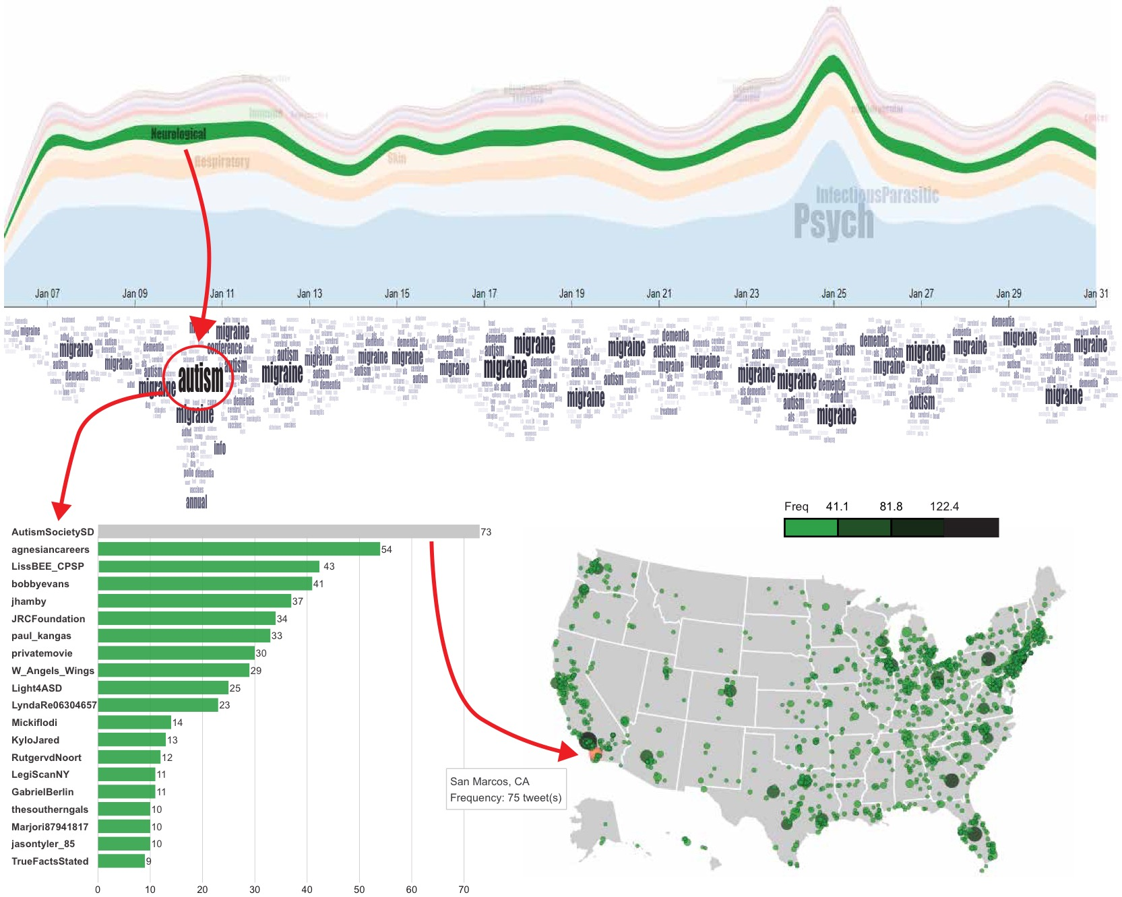
Use case 5: Neurological diseases
In the keyword stream, “Autism” stands out on January 10. Examining the user’s tweets from the user list, we found that the user AutismSocietySD share lots of tweets about the “7th annual swimming with autism conference” in San Marcos, CA. That explains a high frequency of “Autism” on January 10, 2017.

Slide 17
Informal User study
We solicited qualitative responses about HealthTvizer
from medical students and associate professor at Health Science
Center at a public university.
They concluded that there is a huge need for these interactive and real-time visualizations for mental health providers in this country. He also mentioned that we could make the argument if more people are talking about something in a certain area then the government needs to devote more resources and attention to that disease or condition in that area
Domain experts agree that HealthTvizer could be useful for doctors who are just starting to decide where to start their careers. Specifically, when people in a specific city discuss lots a disease, they are probably in need of health care services for that condition/disease

Slide 18
Demo
https://healthtvizer.github.io/index.html

Slide 19

Questions?
Email: Tommy.Dang@ttu.edu

